Slide 1

Course Title: Advanced Cryptography Course code: ICT-6115
Presented By: Supervised By:
Md. Tarikul Islam Mr. Ziaur Rahman
IT-23616 Associate Professor
Dept. of ICT, MBSTU.

Slide 2

Group Actions
Title of the Presentation

Slide 3
• Introduction • Definition of Group Actions • Examples of Group Actions • Properties of Group Actions • Applications of Group Actions • Objectives of this Chapter • Conclusion • References
Outlines

Slide 4
Definition: Group actions generalize group multiplication . A group action is a formal way of describing how the elements of a group correspond to transformations of a set. Notation: If G is a group acting on a set X, we write g · x to denote the action of g ∈ G on x ∈ X.
Introduction to Group Actions

Slide 5
1. Identity Property: e · x = x for all x ∈ X, where e is the identity element of G. 2. Compatibility Property: (gh) · x = g · (h · x) for all g, h ∈ G and x ∈ X.
Key Properties of Group Actions

Slide 6
1. Permutation Groups: The symmetric group Sₙ acting on a set of n elements by permuting them. 2. Matrix Groups: The general linear group GL(n, ℝ) acting on vectors in ℝⁿ by matrix multiplication. 3. Geometric Transformations: Rotations and reflections acting on points in the plane.
Examples of Group Actions

Slide 7
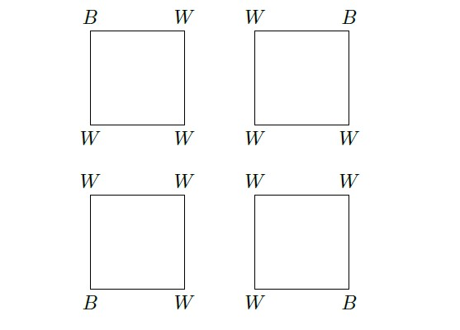
Burnside’s Counting Theorem Suppose that we wish to color the vertices of a square with two different colors, say black and white. We might suspect that there would be 24 =16 different colorings. However, some of these colorings are equivalent. If we color the first vertex black and the remaining vertices white, it is the same as coloring the second vertex black and the remaining ones white since we could obtain the second coloring simply by rotating the square 90◦. Figure: Equivalent colorings of square
Applications of Group Actions

Slide 8
Objectives
• To master the basic theory of group actions.
• To recognize real-world applications of these abstract concepts.
• To develop problem-solving skills using group action techniques.

Slide 9
• Group actions bridge abstract algebra and real-world applications. • Understanding their properties and implications enriches our grasp of symmetry and transformations. • The chapter lays the groundwork for advanced topics like Galois theory and combinatorial group theory.
Conclusion

Slide 10
References
Thomas W. Judson, Abstract Algebra: Theory and Applications.
www.geeksforgeeks.org/
math.libretexts.org

Slide 11
Thank You !

